Slide 1
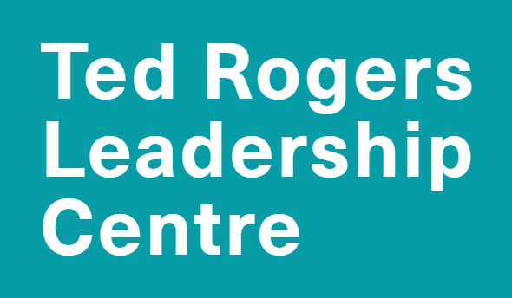
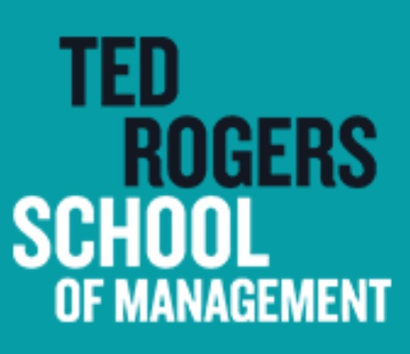
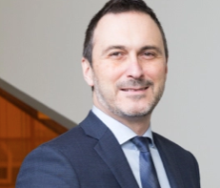
LEADING TO INCLUSION: Increasing the Opportunities for Women in Canada
Chris MacDonald, PhD
Martin Fabro, MBA
April 12, 2018

Slide 2
1.
Introduction
Women in Leadership | Problem Statement | The Business Case

Slide 3
The Present Project
3
Diversity, inclusion, equality are good.
What is the best way to achieve those? What works?
Of the mechanisms that work, which ones are ethically best?
Do the most good.
Do the broadest good.
Impose the fewest harms.
Avoid especially unjust harms.
Impinge on human freedom the least.

Slide 4
Diversity and Leadership
4
Studied for decades (e.g. Hollander & Offermann, 1990)
Focus on the Business Case for Diversity (e.g. Dalton & Dalton, 2005)
The idea that more diverse teams perform better
Some progress made, but slowly
It will take 167 years to achieve
Gender Equality in
North America
(WEF, 2017)

Slide 5
Problem Statement
5
Without significant change, the underrepresentation of women in leadership roles is not going to change anytime soon
Workforce composition in 2014 and forecasted for 2024 for the average organization in North America. Source: Mercer, 2014

Slide 6
How diversity affects performance
6
Creativity and Innovation
(Hewlett, Marshall & Sherbin, 2013)
Problem Solving and Decision Quality
(Leonard, Levine & Joshi, 2004)
Better understanding of clients and Stronger Relations
(Leonard, Levine, & Joshi, 2004)
Employee Retention
(McKay et al., 2007)
Corporate Image
(Nykiel, 1997)
More efficient Marketing Strategies
(Metcalf & Forth, 2000)

Slide 7
2.
Main challenges faced by Women in Management
(And not by Men)

Slide 8
Bias, Discrimination and Prejudice
8
Unconscious Bias and Discrimination are recognized as the main problem (e.g., Arrow, 1998, Blau & Kahn, 2006; Eagly & Chin, 2010).
Double Bind
The agentic requirements of leadership positions vs. the stereotypical communal traits attributed to women
Rather than a glass ceiling, women are facing a labyrinth of
difficulties in her path to leadership
(Eagly & Carli, 2007)
Notes:
Discrimination: Several studies show that the level of discrimination against women is kept constant among every organizational level (e.g. Baxter & Wright, 2000; Elliot & Smith, 2004; Wright, Baxter & Birkelund, 1995).
Double Bind: The consensual expectations for success as a leader usually involves agentic characteristics, leading to a general belief that leadership positions are more suitable for men than for women (Carli & Eagly, 2012; Schein, 1973). The agentic requirements of leadership positions and the stereotypically-driven communal traits given to women enter into conflict when women pursue leadership roles. On one hand, women are expected to be kind, selfless and warm while, on the other hand, they are expected to fit into the leadership role by being assertive and authoritative (Eagly & Carli, 2007). Because of this conflict, when occupying leadership roles, women are usually held to higher standards than men

Slide 9
Mid Career conflict
9
Because of higher levels of discrimination at higher levels, women tend to resign, retire or move out of the pipeline (Carli & Eagly, 2012)
In mid-career stage, the willingness to sacrifice career-life balance and the career ambition levels are higher for men than for women (Jäkel & Moynihan, 2016)

Slide 10
3.
Best Practices

Slide 11
Four main themes
11
Work Flexibility
Talent Pipeline
Progression Gap
Cultural Change

Slide 12
Cultural Change
12
Diversity Training
Anti-Bias Training
Cross-Cultural Training
Why fails?
Mandatory
Resent from managers and employees
Lack of noticeable commitment
What to do?
Voluntary
Change the narrative
Show commitment
More initiatives

Slide 13
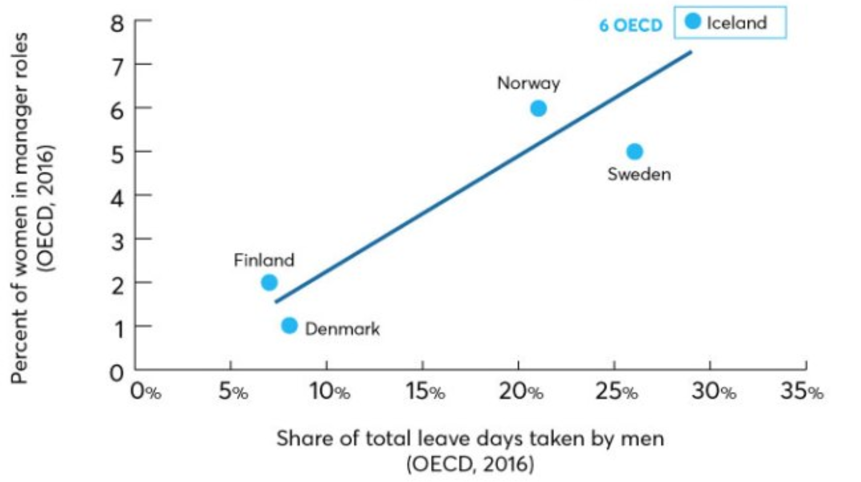
Work Flexibility
13
Flexible Work Arrangements (FWAs)
Parental Leave
Returnship Programs
Percent of Women in Managerial Roles in relation to Share of leave days taking by Man. Source: Athrel, 2016

Slide 14
Talent Pipeline
14
Bias-free Recruitment
Employee Resource Groups (ERGs)
Software that reviews the wording of job postings

Slide 15
Progression gap
15
Sponsorship and Mentorship programs
76%
Mentoring
72%
Promotion
MEN
83%
Mentoring
65%
Promotion
WOMEN
High-potential women are over-mentored and under-sponsored relative to their male peers and they are not advancing in their organizations
(Ibarra, H; Carter, N. M., & Silva, C., 2010).

Slide 16
Progression gap
16
Quotas
Perceived as unjust (by men)
Fears not realized
Potential Stigma (if they are few)
Reduced employee engagement
Reduced support for diversity initiatives
Failure to address bias and discrimination
No pipeline problem
No stigma (If more than 40%)
substantial positive effects
Shock to the system

Slide 17
4.
Project Outputs

Slide 18
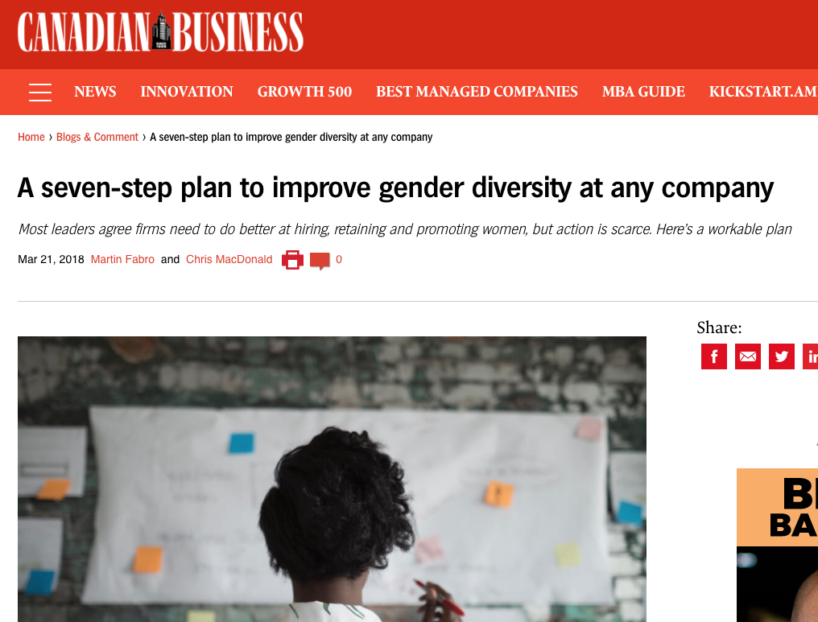
Knowledge Translation, part 1
18

Slide 19
Knowledge Translation, next steps
19
“Best Practices in Gender Diversity”
“Ethics of…
Diversity Training
Quotas
Sponsorship & mentorship
Etc.
Then: White paper summarizing empirical work. Then peer-reviewed paper on ethics.

Slide 20
Thanks!
Any questions?

