Slide 1
Applying for a Canada Graduate Scholarship-
Master’s (CGS M)

Slide 2
Agenda
What is the Canada Graduate Scholarships-Master’s Program?
Am I Eligible to Apply?
maximum months of full-time studies
Selecting the Appropriate Federal Granting Agency
What are the selection criteria?
How do I Apply?
Application Process
Application Checklist
The Research Proposal
Attachment Standards
Upcoming Dates and Deadlines
Resources
Questions & Answers

Slide 3
What is the Canada Graduate Scholarships-Master’s Program?
$17,500 for 12 months, non-renewable
Provides support for students who demonstrate a high standard of achievement in undergraduate and early graduate studies
Administered jointly by Canada’s three federal agencies:
Canadian Institutes of Health Research (CIHR)
Natural Sciences and Engineering Research Council of Canada (NSERC)
Social Sciences and Humanities Research Council of Canada (SSHRC)
Using the Research Portal, students direct their application to the institution(s) at which they intend to hold their award. Awards must be held at the institution where the offer of award originates. Awards are not intended to be portable.

Slide 4
Am I Eligible to Apply?
be a Canadian citizen or a permanent resident of Canada;
be enrolled in, have applied for, or will apply for full-time admission to an eligible graduate program at the master’s or doctoral level at a Canadian institution with a CGS M allocation;
Have applied for admission for your intended program of study before the internal deadline
not have previously held a CGS M;
have achieved a first-class average (“A-” or above), in each of the last two completed years of study (full-time equivalent);
submit a maximum of one scholarship application per academic year to either CIHR, NSERC or SSHRC.
not have exceeded the maximum number of months of full-time study (see next page)
An eligible graduate program must have a significant research component.
Read more: Canada Graduate Scholarships-Master’s Program Eligibility

Slide 5
Am I Eligible to Apply? - maximum months of full-time studies
As of December 31, between zero and 12 months in: (that is, current student in or applicant to )
A master’s program
A direct-entry master’s-doctoral program
A combined master’s-doctoral program
A fast-track master’s-doctoral program
a master’s program for which the degree requirements will be completed before the END of the award, allowing the award to continue into an eligible doctoral program
As of December 31, between four and 12 months in: (that is, current student in)
an eligible master’s program for which the degree requirements will be completed before ACTIVATION of the award, allowing it to be activated during the subsequent doctoral program for which you are requesting funding;
Definitions and Descriptions: Canada Graduate Scholarships-Master’s Program Eligibility

Slide 6
Selecting the Appropriate Federal Granting Agency
SSHRC | NSERC | CIHR
social sciences and humanities | natural sciences and engineering, other than the health sciences | health sciences
research must primarily be to add to our understanding and knowledge of individuals, groups, and societies - what we think, how we live and how we interact with each other and the world around us. | research must primarily be to advance knowledge in one or more of the natural science or engineering disciplines. | research must primarily improve or have an impact on health and/or produce more effective health services and products and/or strengthen the Canadian health care system.
Read more: Selecting the Appropriate Federal Granting Agency

Slide 7
What are the selection criteria?
Academic excellence (50%) | Research potential (30%) | Personal characteristics and interpersonal skills (20%)
Academic record Scholarships and awards held Duration of previous studies Type of program and courses pursued Course load Relative standing (if available) | Quality and originality of contributions to research and development Relevance of work experience and academic training to field of proposed research Significance, feasibility and merit of proposed research Judgment and ability to think critically Ability to apply skills and knowledge Initiative and autonomy; Research experience and achievements relative to expectations of someone with the candidate’s academic experience. | Work experience Leadership experience Project management including organizing conferences and meetings The ability or potential to communicate theoretical, technical or scientific concepts clearly and logically in written and oral formats Involvement in academic life; Volunteerism/community outreach.
Read more: Selection Criteria

Slide 8
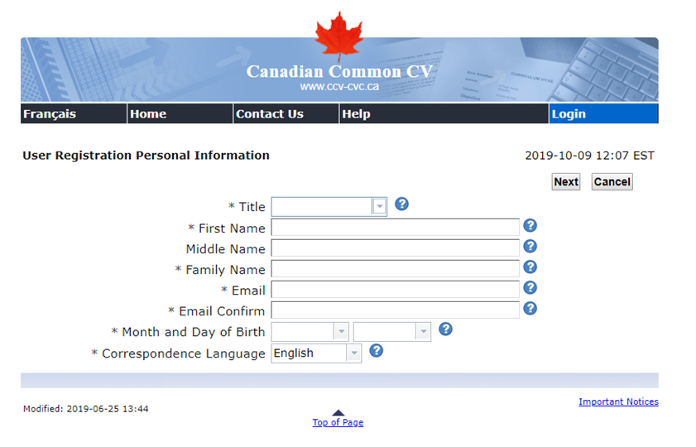
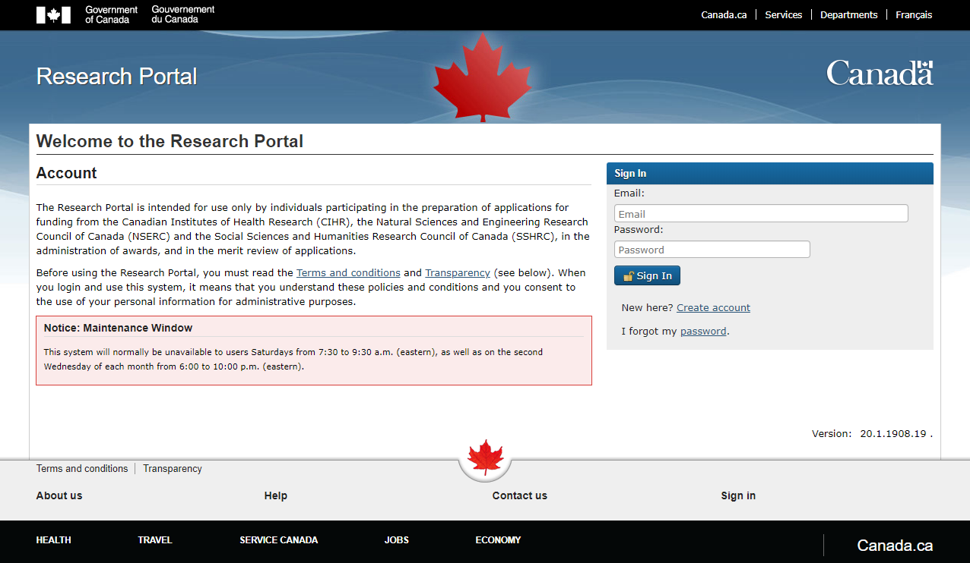
How do I Apply?
Research Portal https://portal-portail.nserc-crsng.gc.ca/s/login.aspx
Canadian Common CV (CCV) https://ccv-cvc.ca/

Slide 9
Application Process
Prepare
Upload
Verify and Submit
Collect your documents
Contact your two referees as soon as possible
Create an application on Research Portal
Create, Update and Save your Canadian Common CV
CGS M Canadian Common CV
Outline of Proposed Research
Bibliography and citations
Up-to-date transcripts
Verify that the application is complete
Select “Export application and attachments to PDF”
Review
Select the “Submit” button
Accept the Terms and Conditions
Read more: Instructions for completing an application

Slide 10
Application Process - Proposed host institution
You must declare the proposed host institution & department
You can select up to three institutions. Example: TMU, Institution 2, Institution 3
You may select an institution only once, and you may select only one department per institution.
New applicants: You must apply for both admission and CGS-M to be considered for CGS-M
Read more about the application process.

Slide 11
Application Checklist
CGS M Canadian Common CV (CCV)
Online Application form
Outline of the proposed research, including Bibliography and Citations
Up-to-date transcripts of all undergraduate and graduate studies
Two reference assessments
A green checkmark will appear when each completed section has been saved and validated and when each reference assessment has been received. You cannot submit an incomplete application.
Remember to Save and Validate frequently; otherwise, the information entered will be lost.
Read more: Instructions for completing an application

Slide 12
Checklist: CGS M Canadian Common CV (CCV)
You are required to complete a Canadian Common CV.
Select as Funding Source: “CGS-Master’s”
Select as CV Type: “CGS-Master’s”
Mandatory fields are indicated with an asterisk (*).
Once you have completed the CGS M CCV and all sections have a green checkmark, click “Submit”.
A confirmation number will automatically be provided. Keep track of this number.
Back in Research Portal, in the Application Overview, go to “Canadian Common CVs Attached section”
Enter your CGS M CCV confirmation number and select “Upload”.
Read more: Instructions for completing a Canadian Common CV

Slide 13
Checklist: Online Application form
Go to Research Portal and select Create Applications (“CGS M program”)
Application overview
Identification
Application (Project) title
Field of Research
Proposed start date of program of study (i.e. September 2021)
Number of months of graduate studies completed as of December 31
Proposed host institution & department (You can select up to three institutions. TMU, 2 ,3)
You may select an institution only once, and you may select only one department per institution.
Summary of proposal: Maximum of 1,800 characters including spaces of your Outline of proposed research in language that the public can understand.
Read more: Instructions for completing an application

Slide 14
Checklist: Online Application form (continued)
Activity details
Themes (if you selected Health as your field of research)
CIHR Personal Identification Number (if you selected Health as your field of research)
Certification requirements (research-ethics related questions)
Sex- and gender-based analysis
Keywords and fields of study
Read more: Instructions for completing an application

Slide 15
Checklist: Outline of the proposed research (1 page)
Maximum of one page
A detailed description of your proposed research project
Outline the objectives of your research, the context, methodology and contribution to the advancement of knowledge.
Ideas and text belonging to others must be properly referenced.
(We provide some writing and formatting tips later…)

Slide 16
Checklist: Bibliography and Citations (1 page)
Provide a bibliography that includes citations for all works referenced in the research proposal.
Just one page of references, but you can probably include 20-25 items on the page.
These citations should be in a format used by the primary discipline of the proposed research.
You must ensure that all citations are clear and complete, to allow reviewers to easily locate the sources.
Read more: Instructions for completing an application

Slide 17
Checklist: Up-to-date Transcripts
Official Up-to-date transcripts of all undergraduate and graduate studies - through myCreds or scanned as a single document.
Up-to-date transcripts are defined as
transcripts dated or issued in the fall session of the year of application (if currently registered), or
after the last term completed (if not currently registered).
Include one copy of the legend (reverse of each transcript). Do not scan the legend multiple times.
PDF file (.pdf extension); unprotected.
Maximum file size of 10 mb (black and white recommended).
Page size 8 ½ in. x 11 in. (216 mm x 279 mm) or A4 (210 mm x 297 mm).
The text orientation should be upright (if possible) and must be readable on a computer monitor without any adjustment by the viewer.
Keep the paper copy of any uploaded transcripts, as you may be asked to provide it.
Read more: Instructions for completing an application

Slide 18
Checklist: Two Reference Assessments
You must contact your referees as soon as possible to ensure they are willing to provide a GOOD reference for you before December 1. Provide them with a copy of your proposal and CV.
Provide your referees with these instructions:
Canada Graduate Scholarships-Master’s Program – Instructions for completing the reference assessment form
Canada Graduate Scholarships–Master’s Program – Instructions for completing the reference assessment form (tutorial video)
The letters should address:
Your Academic Excellence, as demonstrated by past results, transcripts, awards & distinctions
Your Research Potential, as demonstrated by your research history, interest in discovery, the proposed research, its potential contribution to the field, and any anticipated outcomes
Your Personal Characteristics and Interpersonal Skills, as demonstrated by past professional and relevant extracurricular activities and collaborations.
Read more: Instructions for completing an application
Notes:
Advise your referees to do this by November 15.

Slide 19
Checklist: Two Reference assessments (continued)
In the Invitations section of your application, enter the required contact information for each of your referees.
Once the information is saved, your referees will receive a system-generated email containing the link to their reference assessment.
Check back frequently to see if the reference has been submitted.
You will not be able to submit your application until these assessments have been completed and linked to your application.
It is your responsibility to make sure your references complete and submit their assessments early enough to allow you to submit your complete application in the Research Portal before the December 1 deadline.
Watch the video: Instructions for Completing the Reference Assessment Form

Slide 20
The Research Proposal – Before Writing
What
Why
How
Who
What issue/question will the research address?
What is already known about the issue or question?
What is your hypothesis?
What do you imagine your conclusion about it will be?
Why is this issue or question important?
Why it matters—to anyone, and to everyone.
Why is this the most appropriate way to explore your questions
Why is this program the best place to do the work?
How will the issue/ question be answered? (“method”)
How have others pursued similar interests?
How is your approach innovative?
How will it advance knowledge in the field?
How your background has prepared you?
Who are you? Why are you qualified to carry out the research?
Who is the audience? Who will read your application?

Slide 21
The Research Proposal - Format & Headings
Background & Context
Objectives & Hypothesis
Methodology
Significance/ Impact
Preparation & Relevant Background
Provide background information to position your proposed research within the context of current knowledge in the field (citing literature pertinent to the proposal).
State the objectives and hypothesis, and outline the experimental or theoretical approach to be taken (citing literature pertinent to the proposal).
Provide a detailed description of your methodology or interpretive or creative approach.
State the significance of the proposed research to a field or fields in the health sciences, natural sciences and/or engineering, or social sciences and/or humanities, as appropriate.
Explain in some detail how your background has prepared you for this project. Connect some of the experiences and items on your CV with aspects of the research project.
Why is this program the best place to do the work?

Slide 22
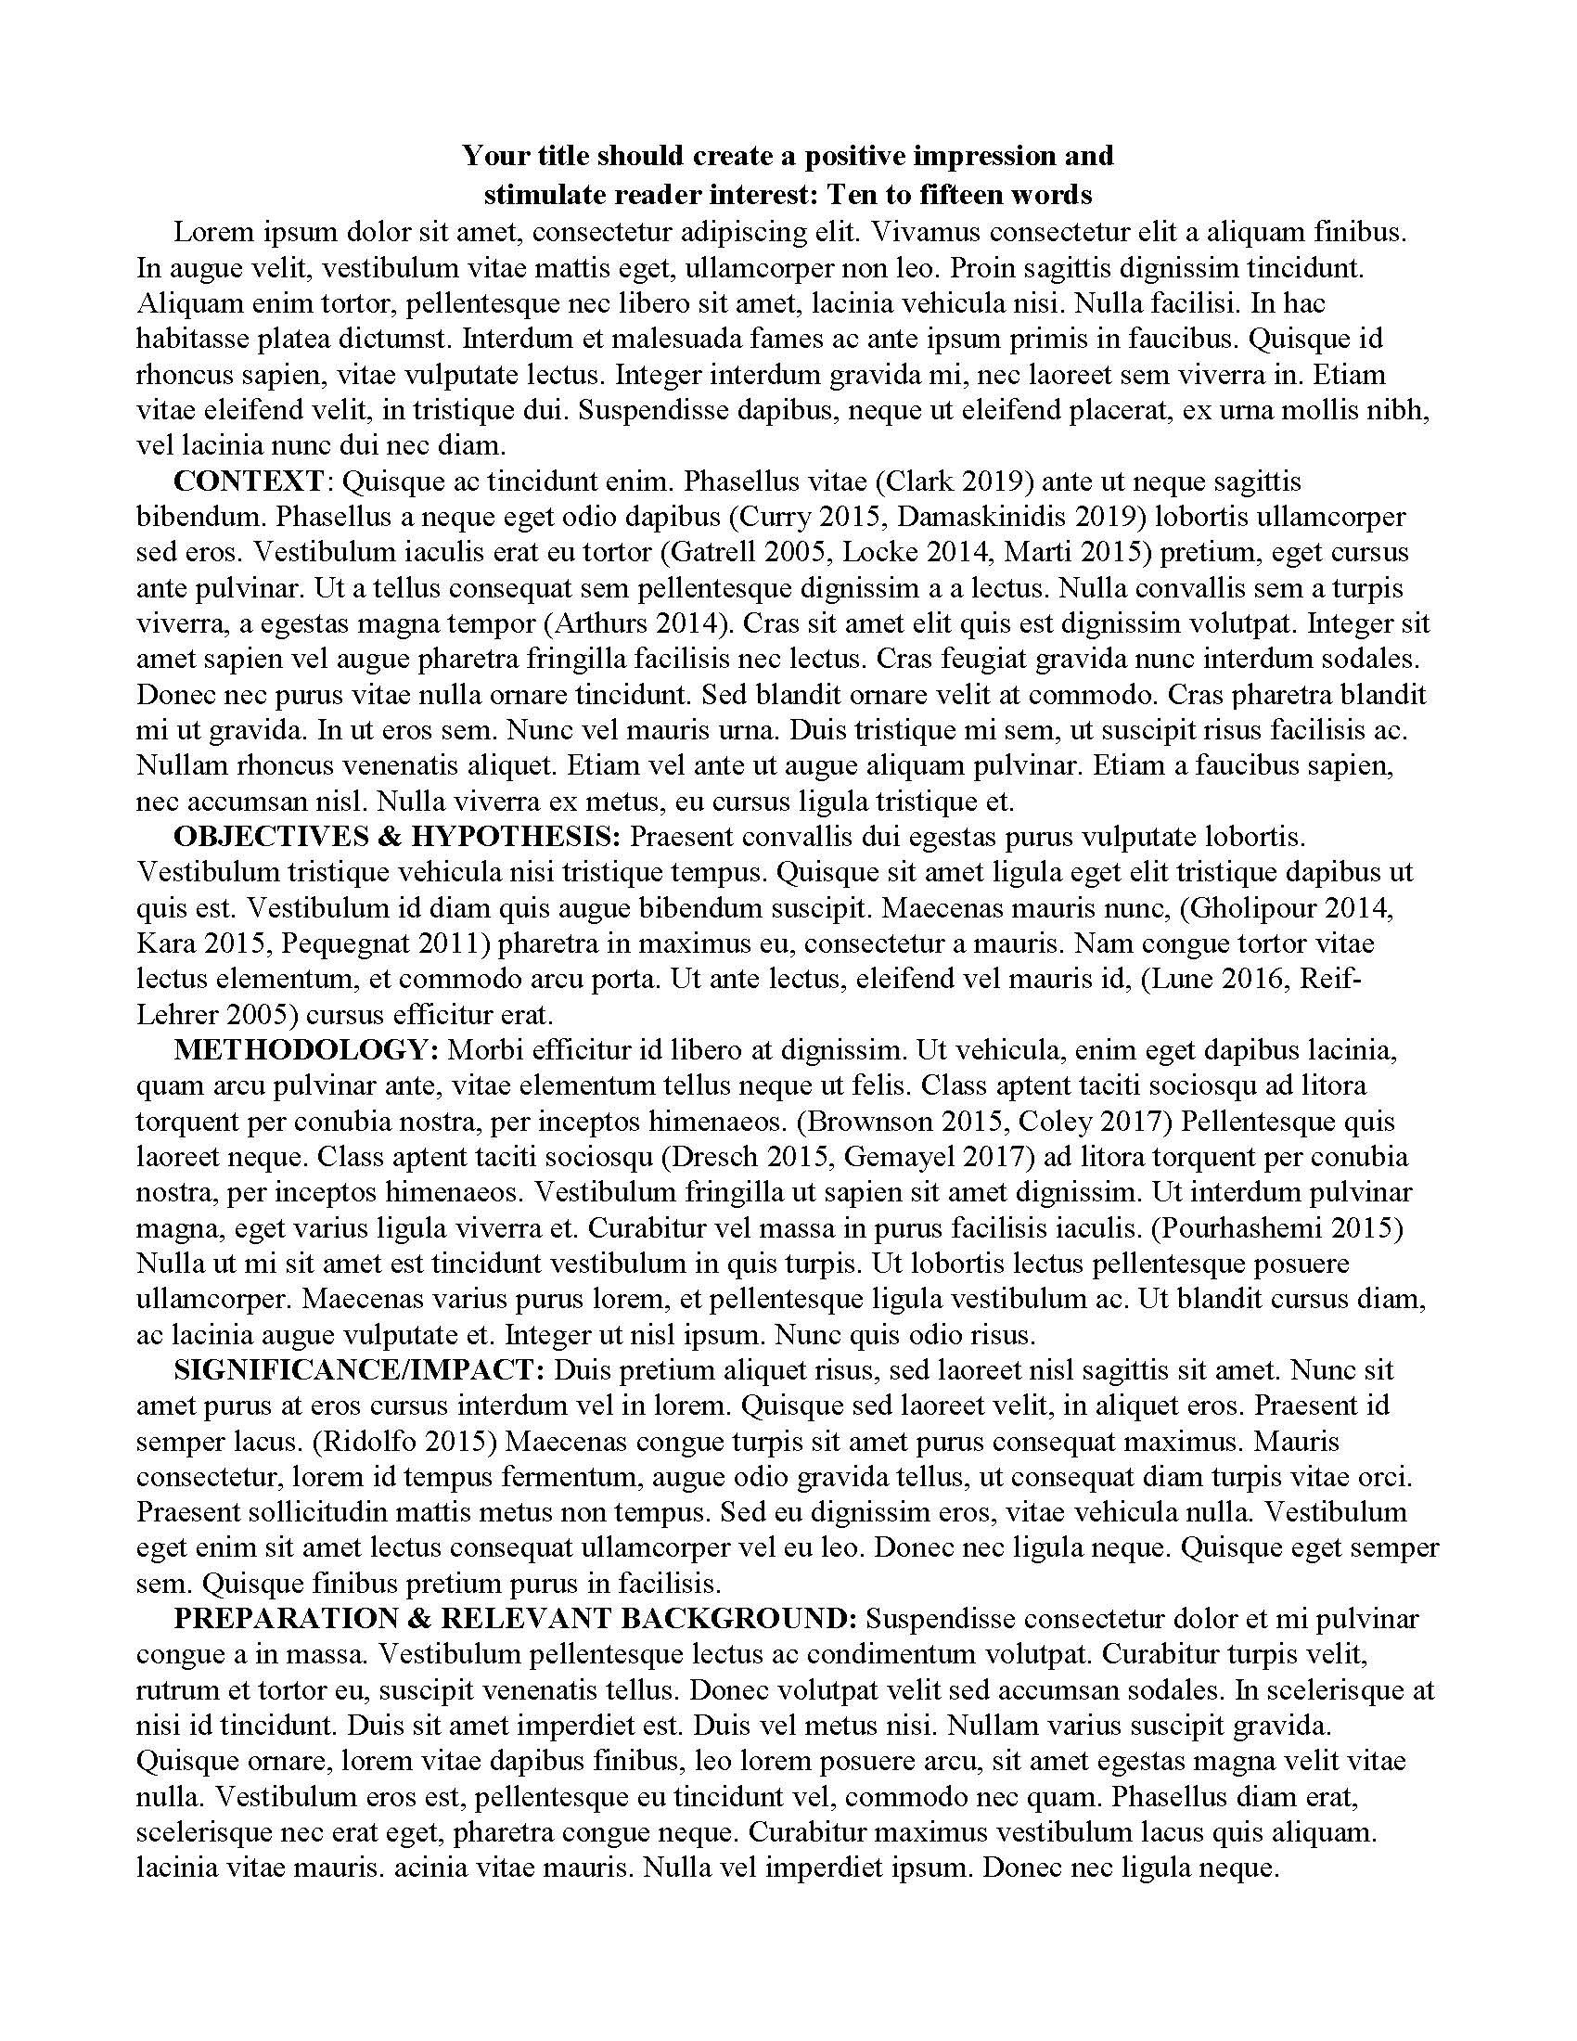
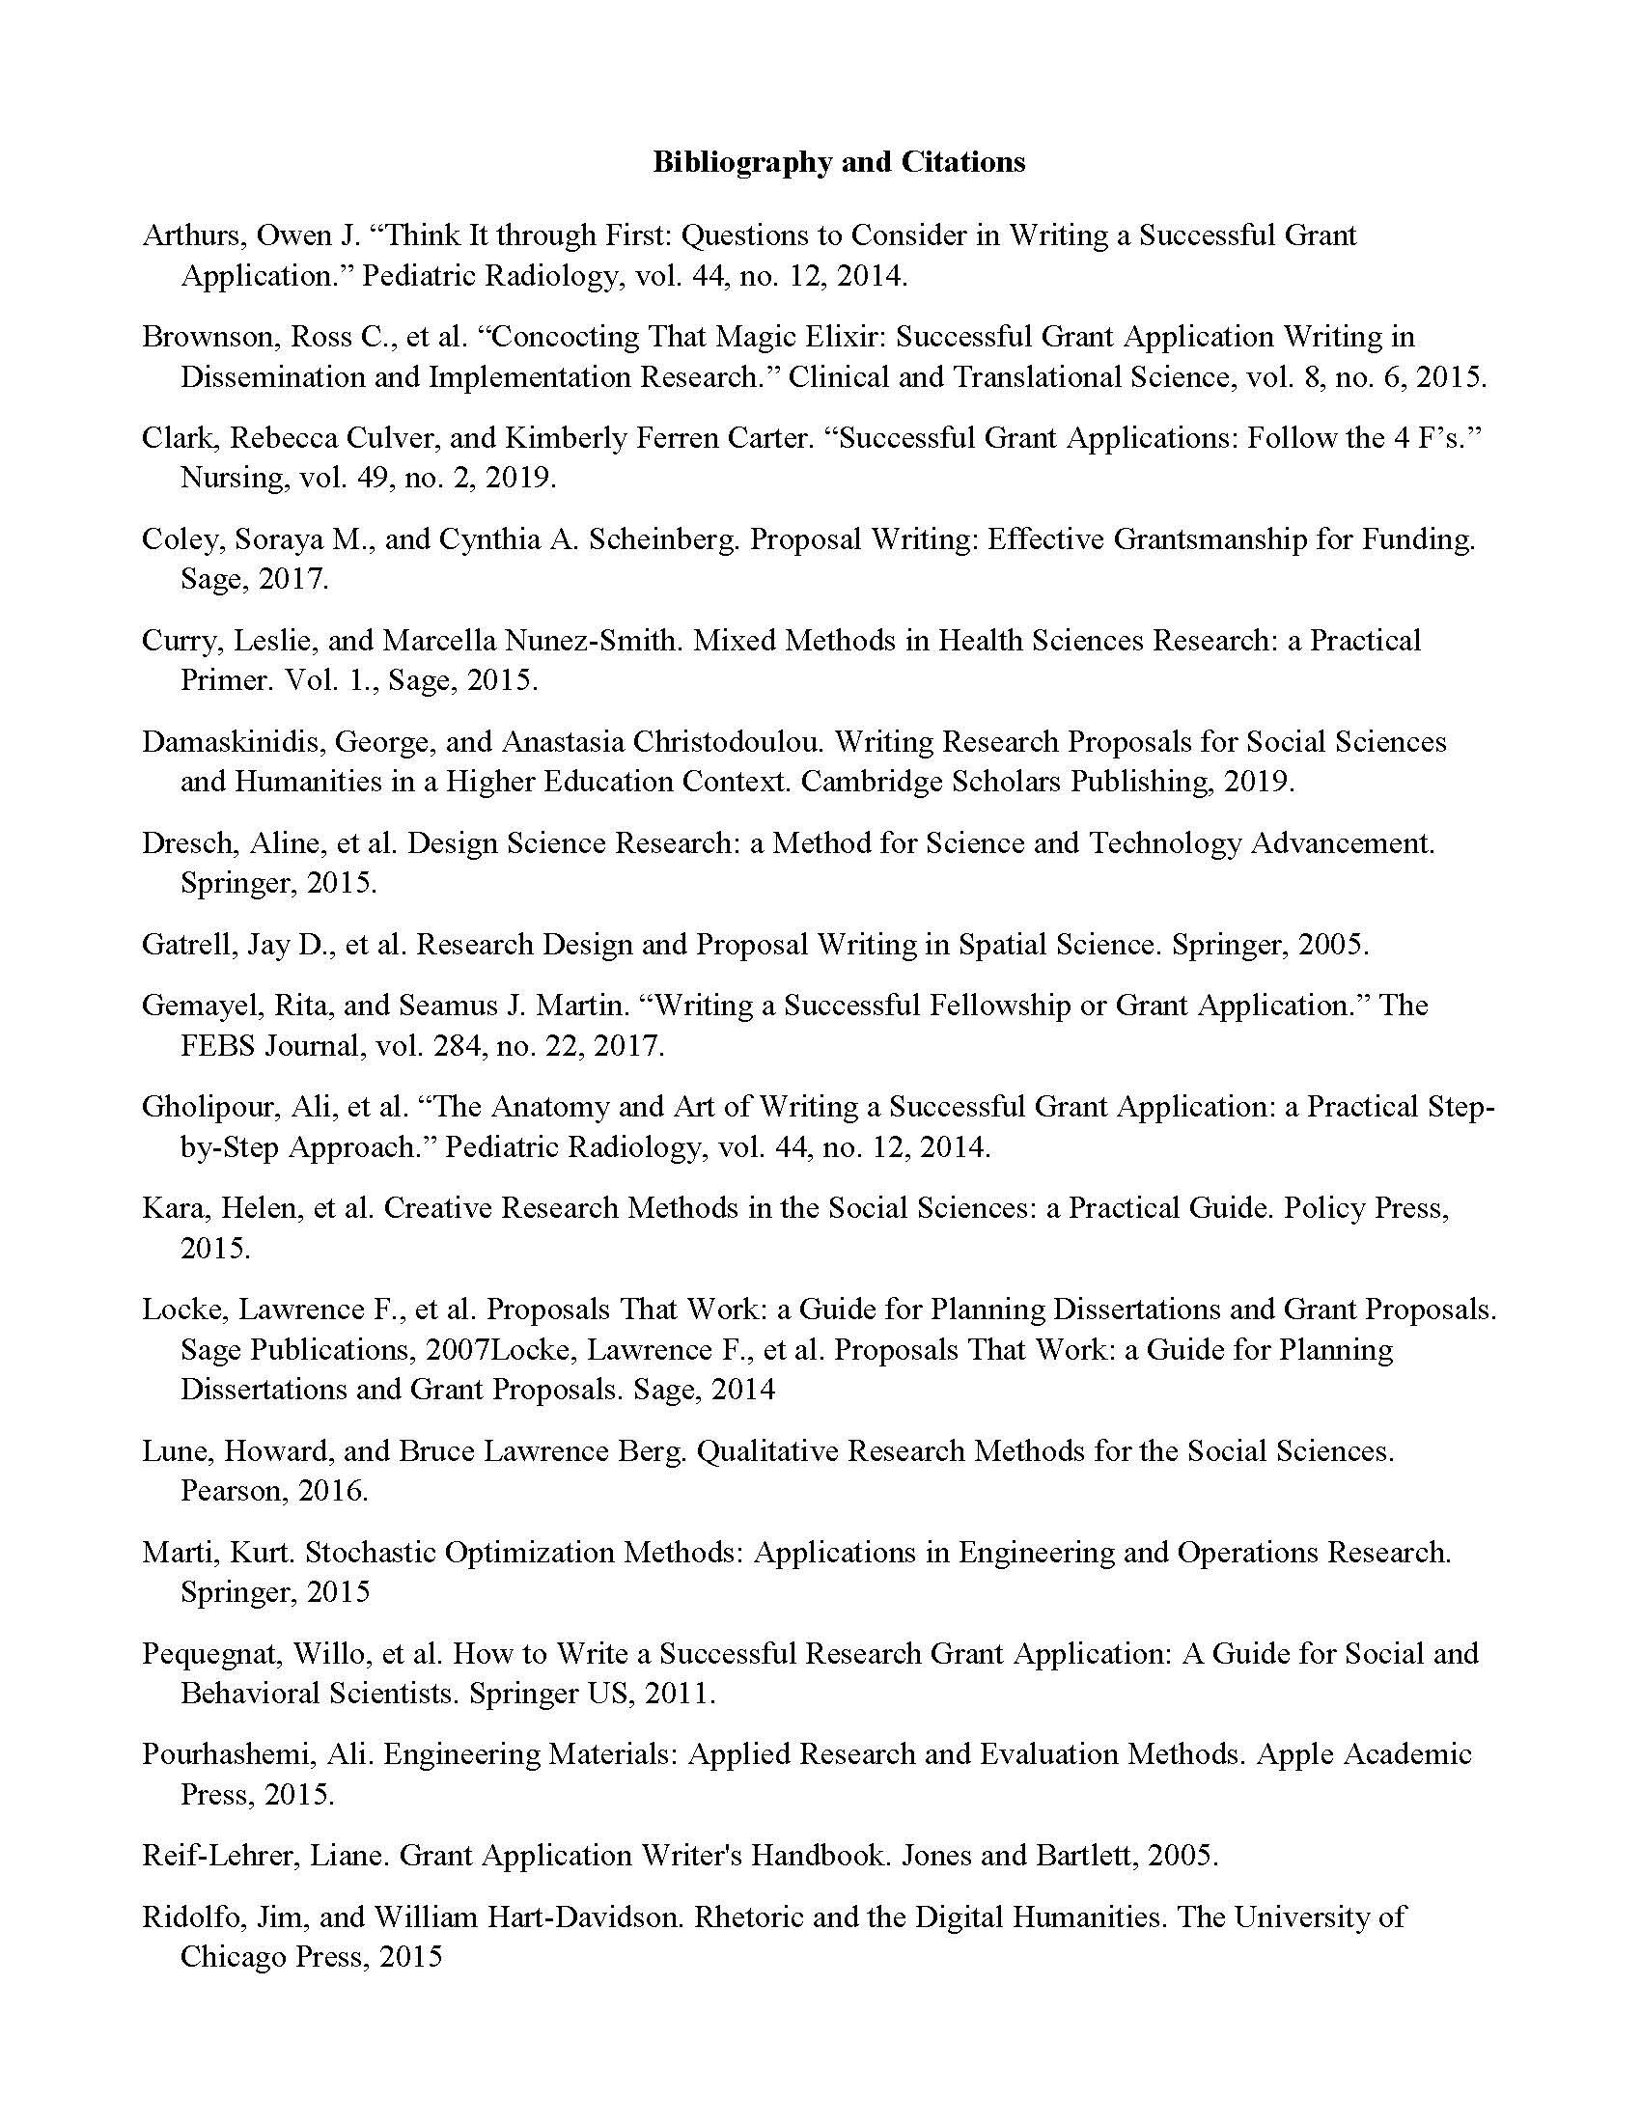
sample layout

Slide 23
The Research Proposal – Writing Tips
Style
Voice
Tone
Be logical. Narrative is important. Avoid grandiose annoying statements and clichés. Write clearly and avoid jargon.
Be credible. Engage the relevant scholarship. Cite key researchers in the field.
Be confident. Believe in what you propose, and write enthusiastically (but not uncritically) about it.
Think about who will read your application!
Try the 30-second rule: can you explain to a non-specialist what you proposed research is about?

Slide 24
The Research Proposal – Advice and Resources
Scholarships and Fellowships - Making your application stand out
U of Calgary: Creating Strong Applications
UBC: Hot Tips for Scholarship Applications
UBC: Scholarships Workshops
MUN: Optimize your chance for Success (pdf)

Slide 25
Attachment Standards
Stick to the page limit. Extra pages are not allowed.
Upload PDF files (.pdf extension); unprotected.
Pages must be 8 ½" x 11" (216mm x 279mm);
Pages must be single-spaced, with no more than six lines of type per inch;
All text must be in 12 pt. Times New Roman font;
Condensed fonts will not be accepted;
Colour: black and white recommended. Colour imagery is acceptable but all the text should be in black;
All margins must be set at a minimum of ¾" (1.87 cm);
Do not introduce hyperlinks in your documents;
If you have supporting documents written in a language other than English or French, you are required to provide a certified translation of the document.
Read more: Research Portal Presentation and Attachment Standards.

Slide 26
Upcoming Dates and Deadlines
Contact your referees as soon as possible.
Upload your Transcripts as soon as possible.
Application deadline: December 1, before 8:00 p.m. (ET).
Do not wait until the last minute.
Research Portal Helpdesk (technical difficulties) Monday to Friday; 8:30 a.m. to 4:30 p.m., eastern
Competition results will be available in the Research Portal as of April 1.

Slide 27
Resources
The following resources are available on the CGS M website
Instructions for completing an application
Instructions for completing a Canadian Common CV
Instructions for completing the reference assessment form
Instructions for completing the reference assessment form (tutorial video)
Research Portal Helpdesk (technical difficulties) Monday to Friday; 8:30 a.m. to 4:30 p.m., eastern

