Slide 1
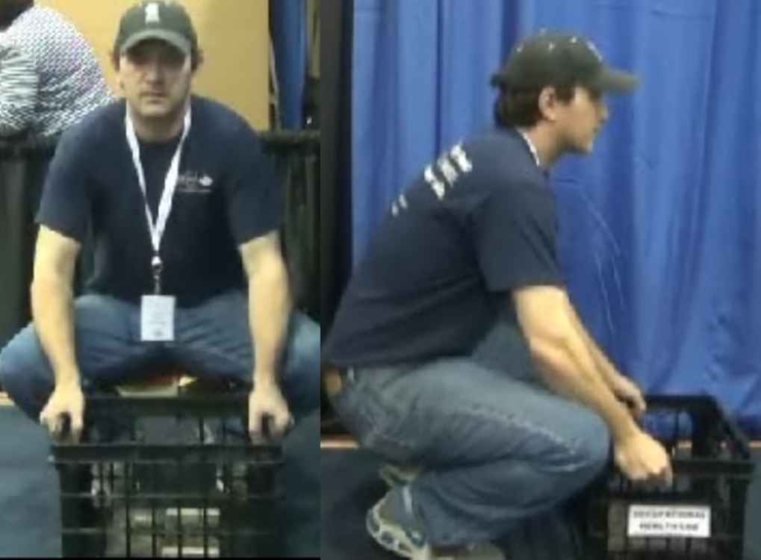
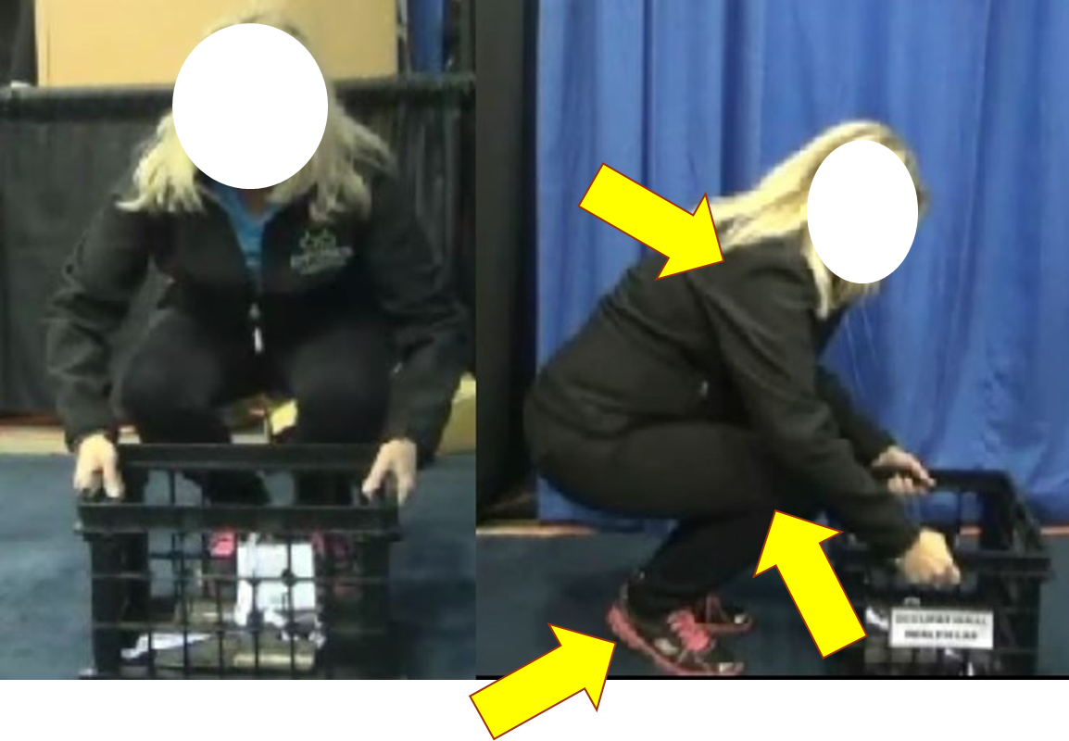
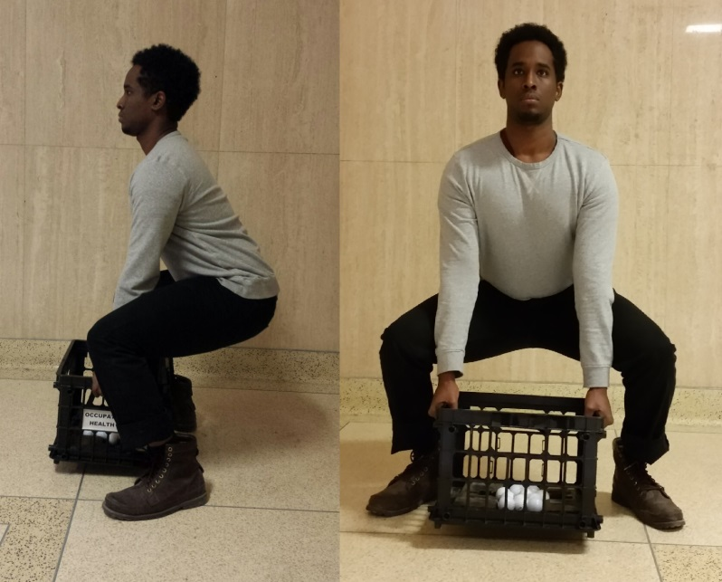
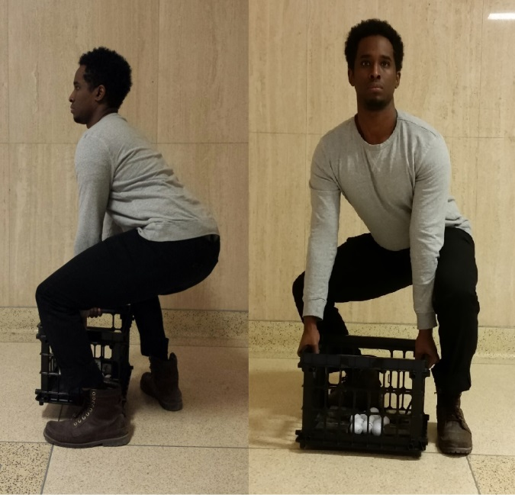
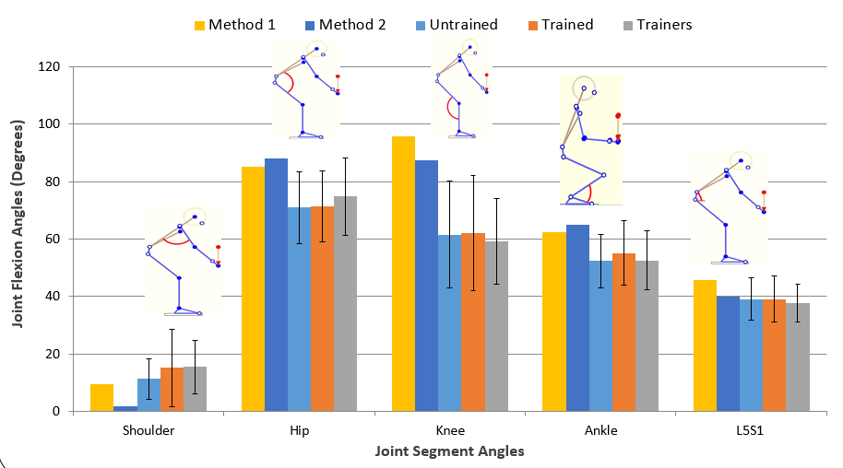
Do you lift a load from the ground properly? Part I-Kinematics
Kinematic evaluation of lifting among Untrained, Trained and Trainers
Mohamed Mohamud, Joseph Janabi, Milena Agababova, Elena Pasko and Mohammad Abdoli-Eramaki*
*School of Occupational and Public Health, Ryerson University, 350 Victoria St., POD 249, Toronto, ON,
Background
Current Lifting Styles
Discussion
Discussion
Lifting or Manual material handling (MMH) is the process of raising an object from one position to another ¹.
MMH is a common part of the job in many industries ¹.
Numerous financial resources dedicated for training workers in order to reduce musculoskeletal disorders ²
Yet, it is still the most common type of injuries in Ontario workplaces ²
Although retraining is recommended, there is some evidence suggesting that it is generally ineffective ³
Statistics from WSIB show that in the past five years, 20% of high impact injury claims were low back pain due to overexertion ²
28% of workers have to perform MMH as part of their jobs and 23% received training.
9% of workers had back pain that forced them to miss work due to lifting.
Participants believed that Posture 1 (42%) , 3 (19%) and 9 (31%) were the best or correct lifting technique
When participants were asked to choose the best lifting method, 65.3% did not lift and 79.6% did not lower the same method they selected.
Method 2 reduces the shoulder flexion angle by 87%
Method 1 improves the knee flexion angle by 57%
Method 2 increases the ankle flexion angle by 17%
Method 1 enhances the spinal flexion angle by 18%
28% of workers have to perform MMH as part of their jobs and 23% received training.
9% of workers had back pain that forced them to miss work due to lifting.
Participants believed that Posture 1 (42%) , 3 (19%) and 9 (31%) were the best or correct lifting technique
When participants were asked to choose the best lifting method, 65.3% and 79.6% did not lift and lower the same method they selected.
Method 2 reduces the shoulder flexion angle by 87%
Method 1 improves the knee flexion angle by 57%
Method 2 increases the ankle flexion angle by 17%
Method 1 enhances the spinal flexion angle by 18%
Background
Lifting or Manual material handling (MMH) is the process of raising an object from one position to another ¹.
MMH is a common part of the job in many industries ¹.
Numerous financial resources dedicated for training workers in order to reduce musculoskeletal disorders ²
Yet, it is still the most common type of injuries in Ontario workplaces ²
Although retraining is recommended, there is some evidence suggesting that it is generally ineffective ³
Statistics from WSIB show that in the past five years, 20% of high impact injury claims were low back pain due to overexertion ²
What is correct?
Objectives
To compare the kinematics (joint) of lifting techniques of: Untrained, Trained, Trainers (OHS professionals and Ergonomists)
To compare the perception of what is the proper lifting technique and what is actually performed.
Conclusion
The results demonstrated that Method 1 and 2 improve posture angles compared MMH techniques currently seen. Thus indicating that Method 1 and 2 places the body in a safe and stable configuration.
The results indicated that differences in the joint angles between the three categories were insignificant (p>0.1).
There is no significant difference between the genders for joint posture angles (p>0.1).
Therefore this shows that untrained and trained workers lift similarly to their trainers
Some recommendations include that newly developed and widely accepted lifting training styles should be developed for proper manual material handling
Additionally, it is believed that by creating new training materials or improve teaching methods, to help explain how all body joints and segments should work together in order to handle the loads.
Hypothesis
Figure 1: Alternative method 1.
Figure 2: Alternative method 2.
There is a significant difference for kinematics between the three groups
Participants will select the best method and perform what they indicated on the questionnaire.
Results
Objectives
To compare the kinematics (joint) of lifting techniques of: Untrained, Trained, Trainers (OHS professionals and Ergonomists)
To compare the perception of what is the proper lifting technique and what is actually performed.
Methodology
196 healthy participants were recruited during WSPS Conference (2015). Two digital camcorders were placed approx. 10ft away in front and the side of each person in a 90 degree angle. Participants completed questionnaires and then were instructed to lift a 10 kg load from the floor to elbow height. 3DSSPP was used to analyze videos at the point of lifting. Lastly, ANOVA was used to evaluate the impact of gender and training had on the kinematics of various body joints and to compare the results with correct methods 1 and 2.
Conclusion
References
ATLANTA, G., &amp; CENTERS FOR DISEASE CONTROL AND PREVENTION. (2007). Ergonomic Guidelines for Manual Material Handling.
Safety, W., &amp; Board, I. (2015). By the Numbers: 2014 WSIB Statistical Report. Toronto, ON: Workplace Safety and Insurance Board. Available at http://www. wsibstatistics. Ca (Accessed August 3, 2015).
Lynch, R. M., & Freund, A. (2000). AIHAJ-American Industrial Hygiene Association, 61(2), 290-294
The results demonstrated that Method 1 and 2 improve posture angles compared MMH techniques currently seen. Thus indicating that Method 1 and 2 places the body in a safe and stable configuration.
The results indicated that differences in the joint angles between the three categories were insignificant (p>0.1).
There is no significant difference between the genders for joint posture angles (p>0.1).
Therefore this shows that untrained and trained workers lift similarly to their trainers
Some recommendations include that newly developed and widely accepted lifting training styles should be developed for proper manual material handling
Additionally, it is believed that by creating new training materials or improve teaching methods, to help explain how all body joints and segments should work together in order to handle the loads.
Hypothesis
There is a significant difference for kinematics between the three groups
Participants will select the best method and perform what they indicated on the questionnaire.
Methodology
196 healthy participants were recruited during WSPS Conference (2015). Two digital camcorders were placed approx. 10ft away in front and the side of each person in a 90 degree angle. Participants completed questionnaires and then were instructed to lift a 10 kg load from the floor to elbow height. 3DSSPP was used to analyze videos at the point of lifting. Lastly, ANOVA was used to evaluate the impact of gender and training had on the kinematics of various body joints and to compare the results with correct methods 1 and 2.

